Slide 1
Comprehensive EV Charging Network Across Texas
Group 7:
Aadithya Vidyasagar
Brijesh Dungrani
Neil Ray
Priyanka Chandrikapure
Rohit Kumar Singh
Yash Shah

Slide 2
Problem Statement
The widespread adoption of electric vehicles has resulted in a growing need for accessible and reliable charging stations.
However, identifying suitable locations for installing these charging stations is a complex and challenging task.
The lack of EV charging stations has resulted in range anxiety, which is a significant deterrent to the adoption of EVs.
In this project, we aim to develop a solution that leverages data-driven techniques to identify optimal locations for installing charging stations in Texas.

Slide 3
Why the need for EVs?
The United States has set a goal to achieve net-zero greenhouse gas emissions by 2050.
The transportation sector is responsible for approximately 28% of greenhouse gas emissions. Texas is the leading state in emissions from transportation.
Achieving net-zero emissions by 2050 will require a significant effort from all sectors of the economy.
80% of that emission comes from LDVs, MDVs, and HDVs.
Electric vehicle sales in the United States could reach 50 percent of total passenger car sales by 2030.
The sales of MDVs and HDVs are expected to increase by more than 50% per year through 2025.

Slide 4
Why the need for charging stations?
Alleviate Range Anxiety
The limited range of electric vehicles and the need to recharge them makes it essential to have a reliable and comprehensive network of charging stations.
Keep up with the growth of Electric Vehicles
Electric vehicle adoption is rapidly increasing globally, and more charging stations are needed to support this growth.
Encourage widespread adoption of Electric Vehicles
The lack of charging infrastructure is a significant barrier to the widespread adoption of electric vehicles in rural areas
Reduce carbon emissions
Installing charging stations can help reduce carbon emissions by encouraging more people to switch to electric vehicles and reducing the reliance on fossil fuels.

Slide 5
What is our objective?
Develop a comprehensive and reliable network of Type-3 EV charging stations that meets the growing demand of EV users in Texas and alleviate range anxiety.
Promote the adoption of EVs and accelerate the transition to sustainable transportation by providing convenient and accessible charging locations.
Determine the most favorable sites in Texas for the installation of EV charging stations by considering factors such as the potential demand for charging services, proximity to highways and transportation hubs, population density, and consumer behavior.
Assess the practicality and appropriateness of the identified sites by evaluating factors such as area, population, median income and registered EVs.
Provide a list of recommended locations for charging station installation in order of priority based on the conducted analysis.

Slide 6
What is our approach?
Understand
Understand California's strategy for building an EV charging station network in Texas.
Visualize
Use Tableau to compare and visualize important factors between California and Texas.
Model
Create a machine learning model to predict the optimal number of charging stations for Texas.
Analyze
Conduct geospatial analysis of Texas highways to identify the best locations for installing charging stations.
Recommend
Identify and recommend the most appropriate sites for charging station installation in Texas.

Slide 7
What are the factors we considered?
Area
Population
Median Income
Registered EVs
Proximity to Highways
Highway traffic

Slide 8
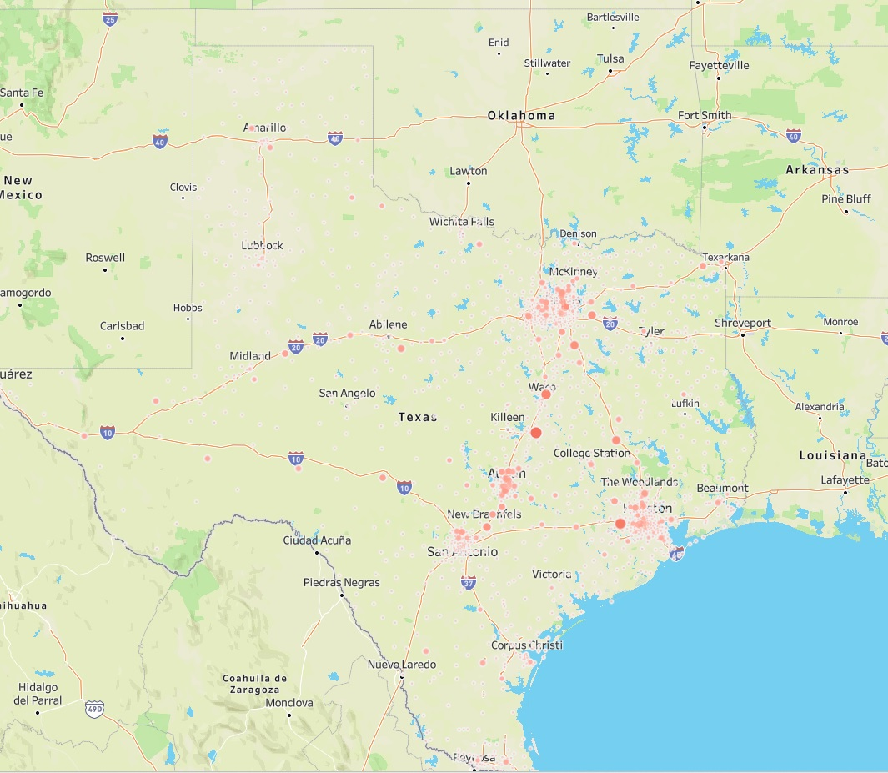
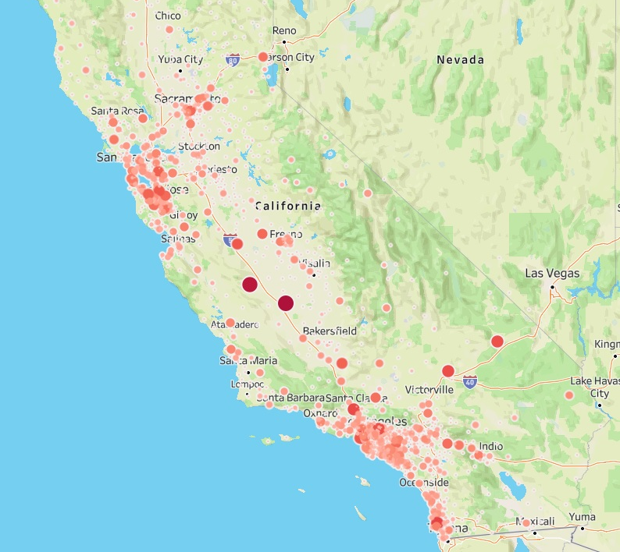
Texas vs California
Comparing level 3 charging station distribution in CA and TX.
The stations are sparse and more spread out in Texas.
Bigger bubbles represent more stations

Slide 9
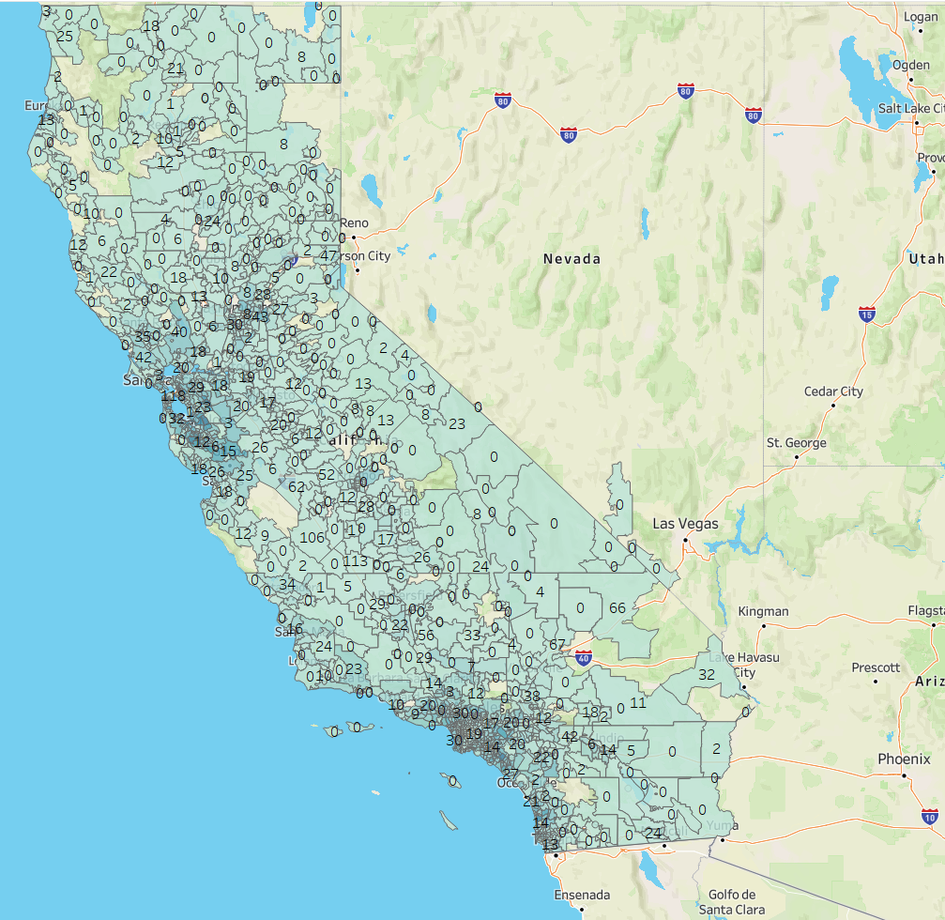
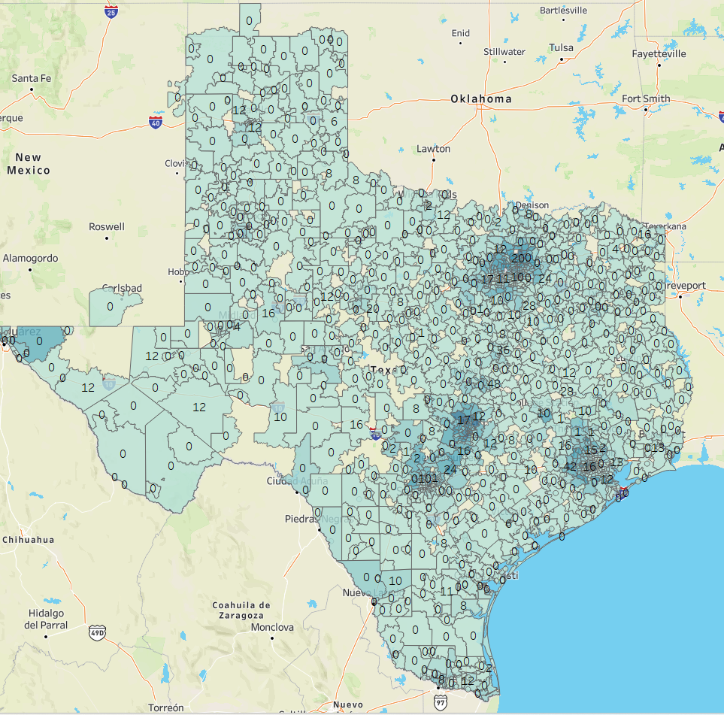
Texas vs California
Analyzing registered EV and DCFC stations relationship.
Zip codes color-coded by number of registered EVs.
Numbers indicate existing DCFC stations in the zip code.
Areas that have more EVs seem to have more DCFC stations.
Positive correlation between EVs and DCFC stations.

Slide 10
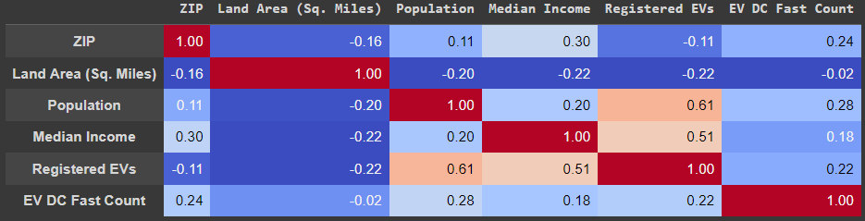
Correlation Matrix
Population and EVs positively correlated.
Income and EVs positively correlated.
Income and EV chargers positively correlated.
EVs and chargers positively correlated.

Slide 11
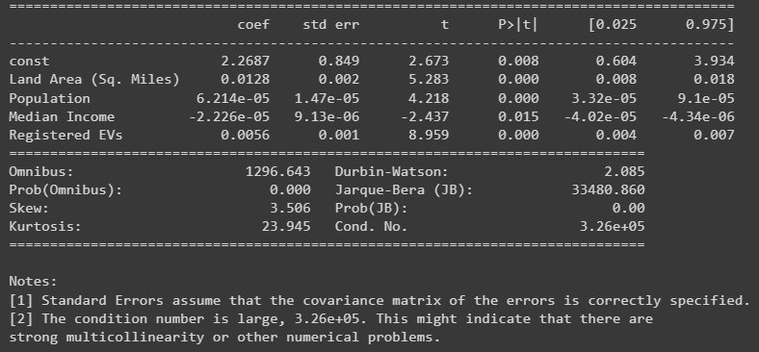
Model Regression Analysis
We trained the model with California’s dataset
The model predicts ideal number of charging stations needed considering all the factors
All the factors are significant at the 5% level
Model was then used on Texas’s dataset to predict the ideal number of DCFC stations.

Slide 12
Cost Analysis
 | 50 kW |  |  |  | 150 kW |  |  |  | 350 kW
 | 1 Chargers per site | 2 Chargers per site | 3-5 Chargers per site | 6-50 Chargers per site | 1 Chargers per site | 2 Chargers per site | 3-5 Chargers per site | 6-20 Chargers per site | 1 Chargers per site | 2 Chargers per site | 3-5 Chargers per site | 6-10 Chargers per site
Labor | $19,200 | $15,200 | $11,200 | $7,200 | $20,160 | $15,960 | $11,760 | $7,560 | $27,840 | $22,040 | $16,240 | $10,440
Materials | $26,000 | $20,800 | $15,600 | $10,400 | $27,300 | $21,840 | $16,380 | $10,920 | $37,700 | $30,160 | $22,620 | $15,080
Permit | $200 | $150 | $100 | $50 | $210 | $158 | $105 | $53 | $290 | $218 | $145 | $73
Taxes | $106 | $85 | $64 | $42 | $111 | $89 | $67 | $45 | $154 | $123 | $92 | $62
Total | $45,506 | $36,235 | $26,964 | $17,692 | $47,781 | $38,047 | $28,312 | $18,577 | $65,984 | $52,541 | $39,097 | $25,654
Performed a cost breakdown for constructing DC fast chargers.
Analyzed various components such as labor, materials, permit costs, and taxes.
The team estimated the average cost of constructing 50 kW, 150kW and 350 kW charging stations.

Slide 13
Geospatial Analysis
The first step was to analyze the population density for all the zip codes.
Next, the complete Texas highway freight network was mapped.
Traffic data was plotted using annual average daily traffic data for each highway, with car traffic greater than 25,000 and truck traffic greater than 500 considered for analysis.
The location of existing DCFC charging stations across Texas was identified.
A circle with a radius of 50 miles was drawn around each charging station to uncover areas that had high traffic but no charging stations.
We marked points where the circle and the highways intersected and then further optimized it to ensure a charging station withing every 50 miles.
Zip codes that required charging stations were identified, and then split into phases.
Priority was given to each phase based on traffic, population, and registered EVs.

Slide 14
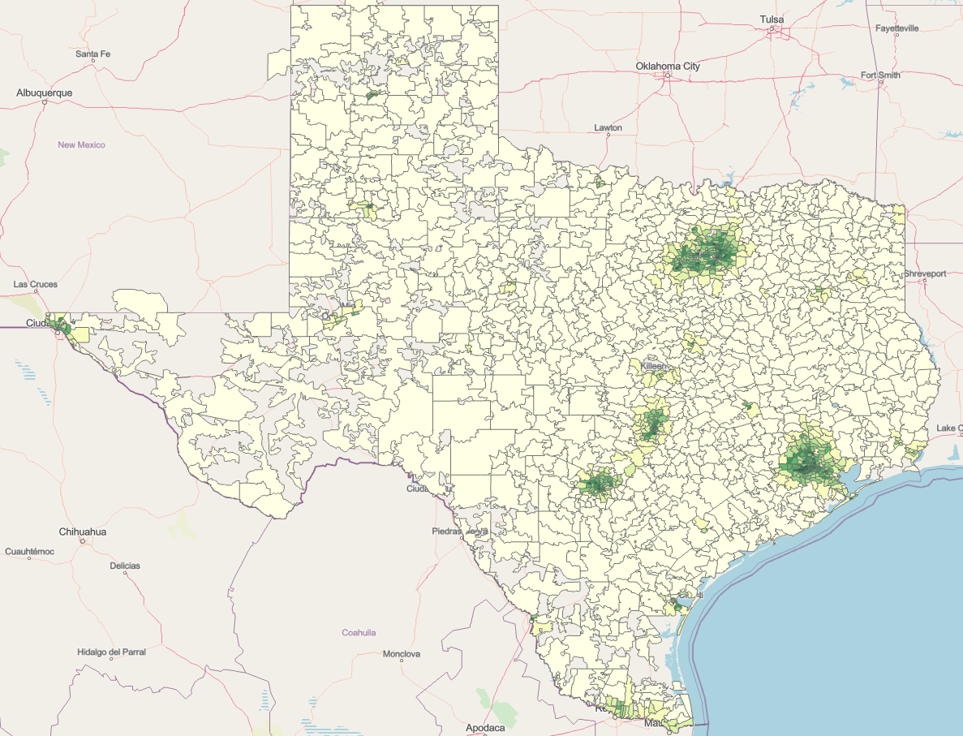
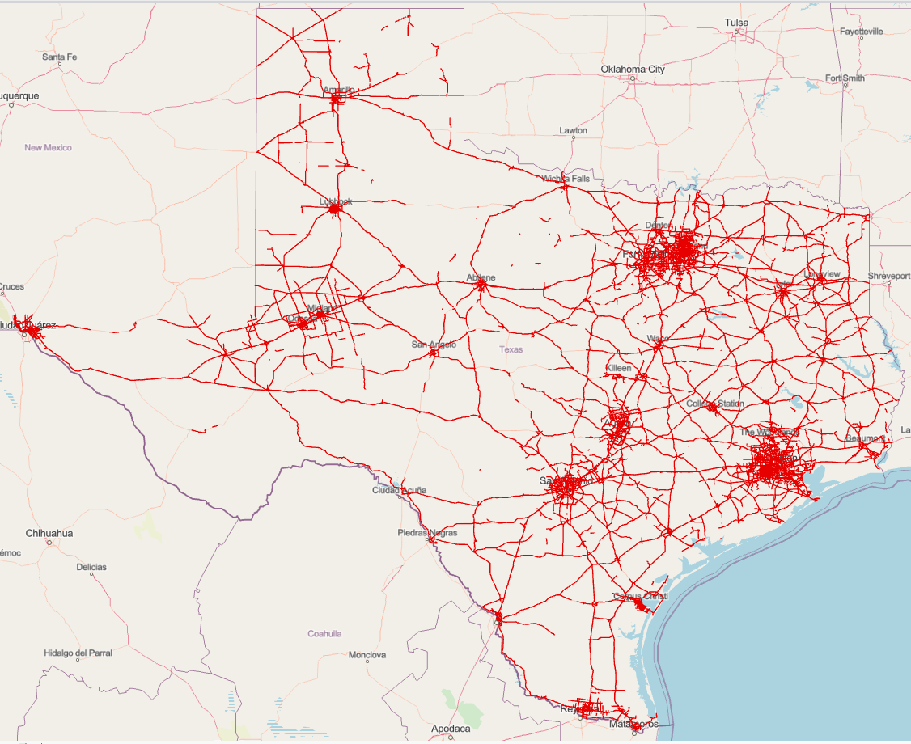
Geospatial Analysis
Population Density across Texas
Highway traffic network in Texas

Slide 15
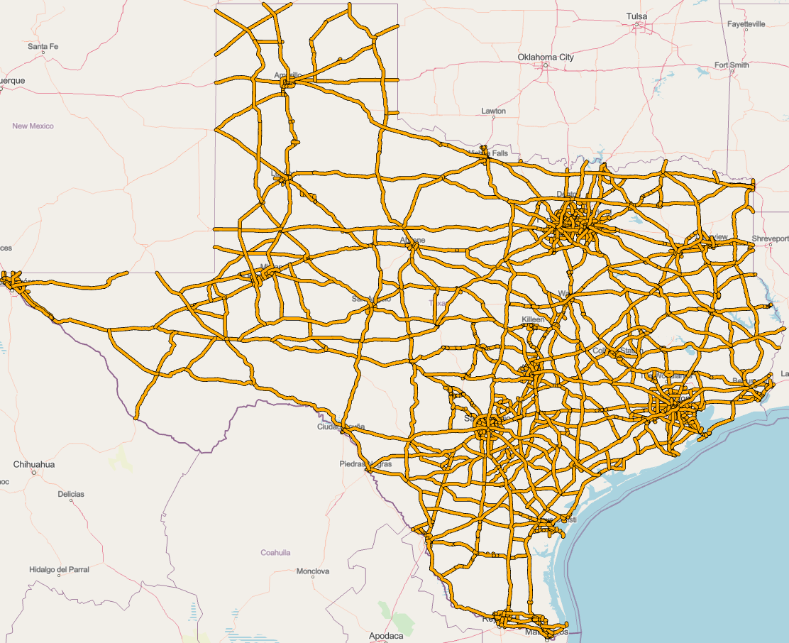
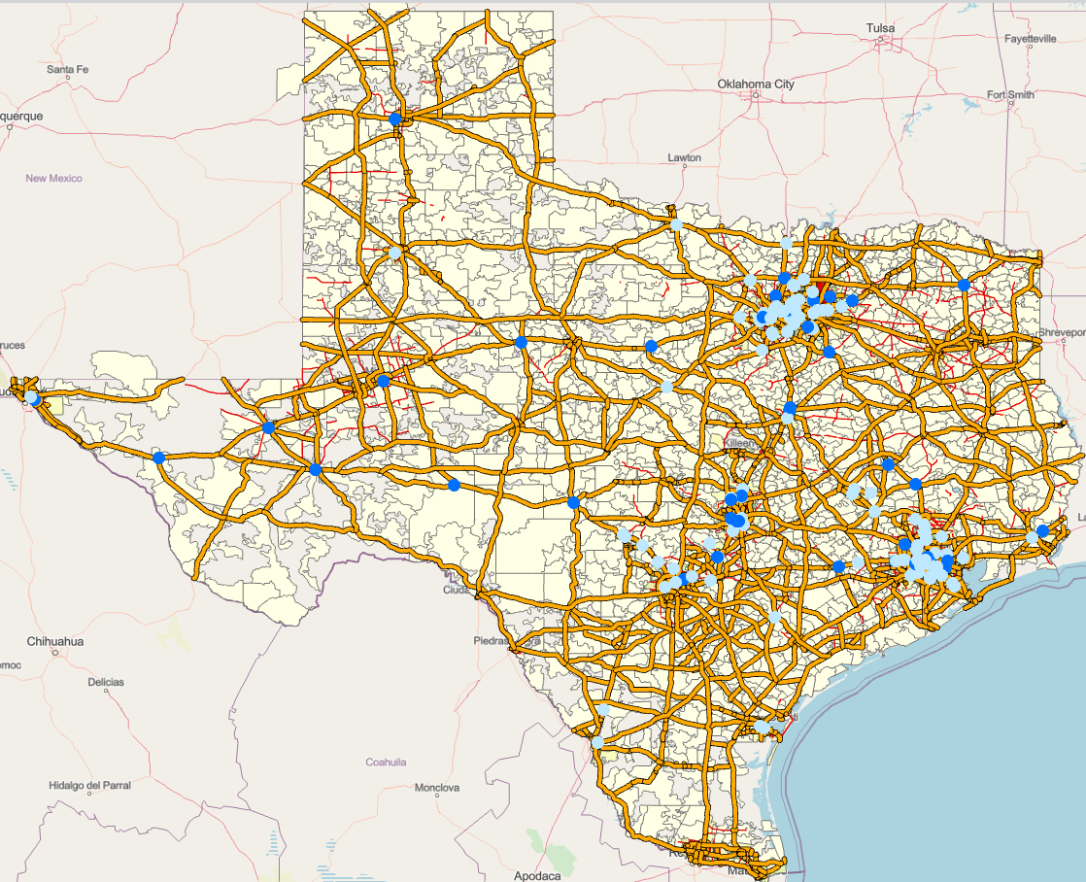
Geospatial Analysis
Highway Freight network in Texas
Existing DCFC ports in Texas

Slide 16
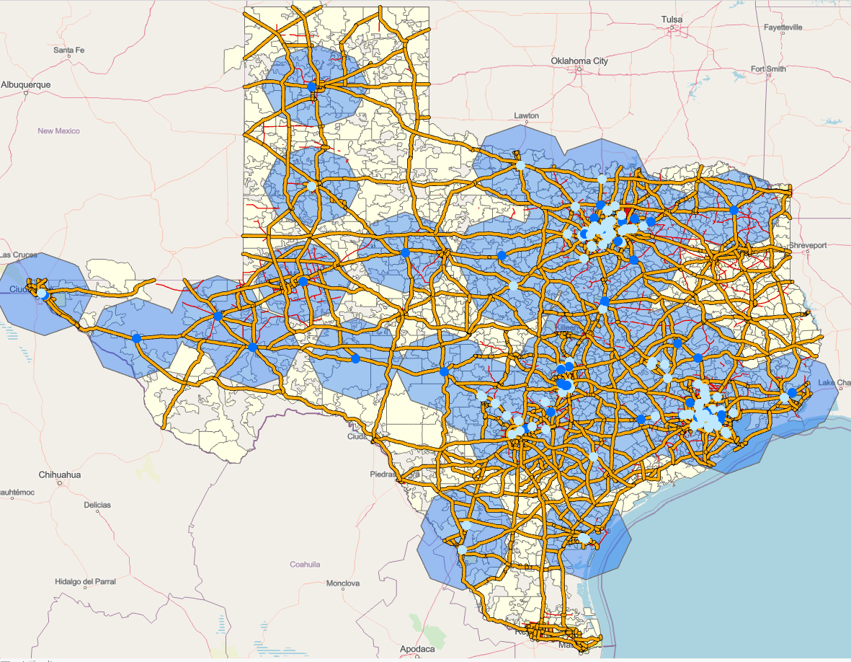
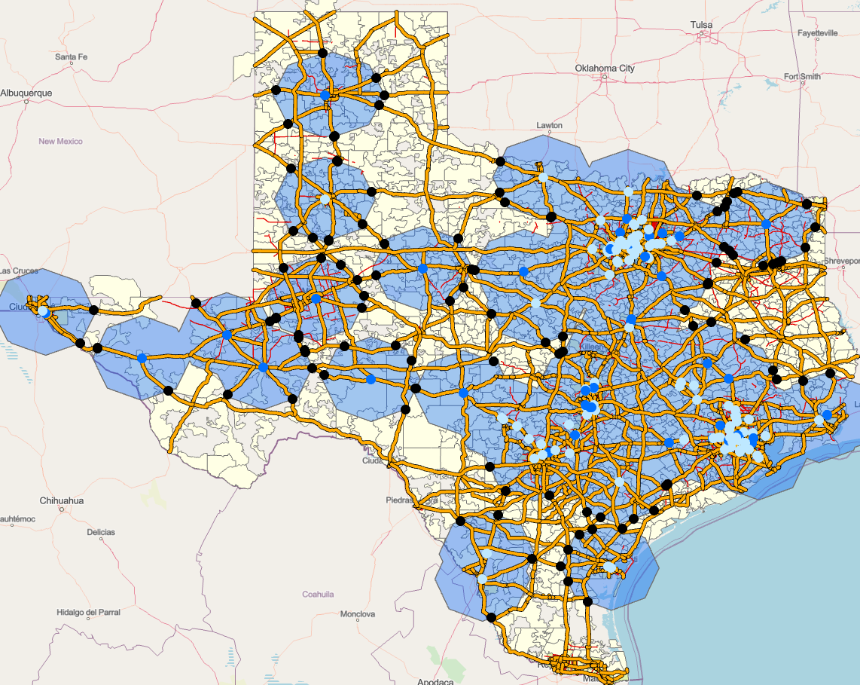
Geospatial Analysis
Areas under 50-mile radius from existing DCFC ports
Points on highways which are 50 miles away from existing stations

Slide 17
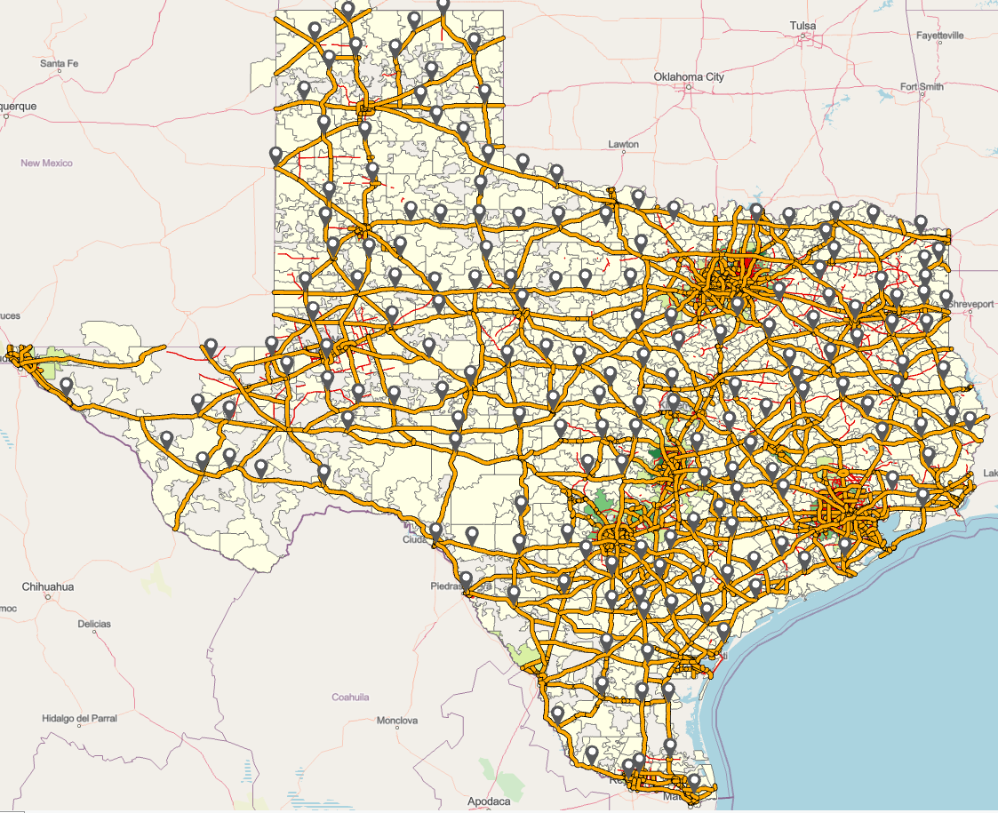
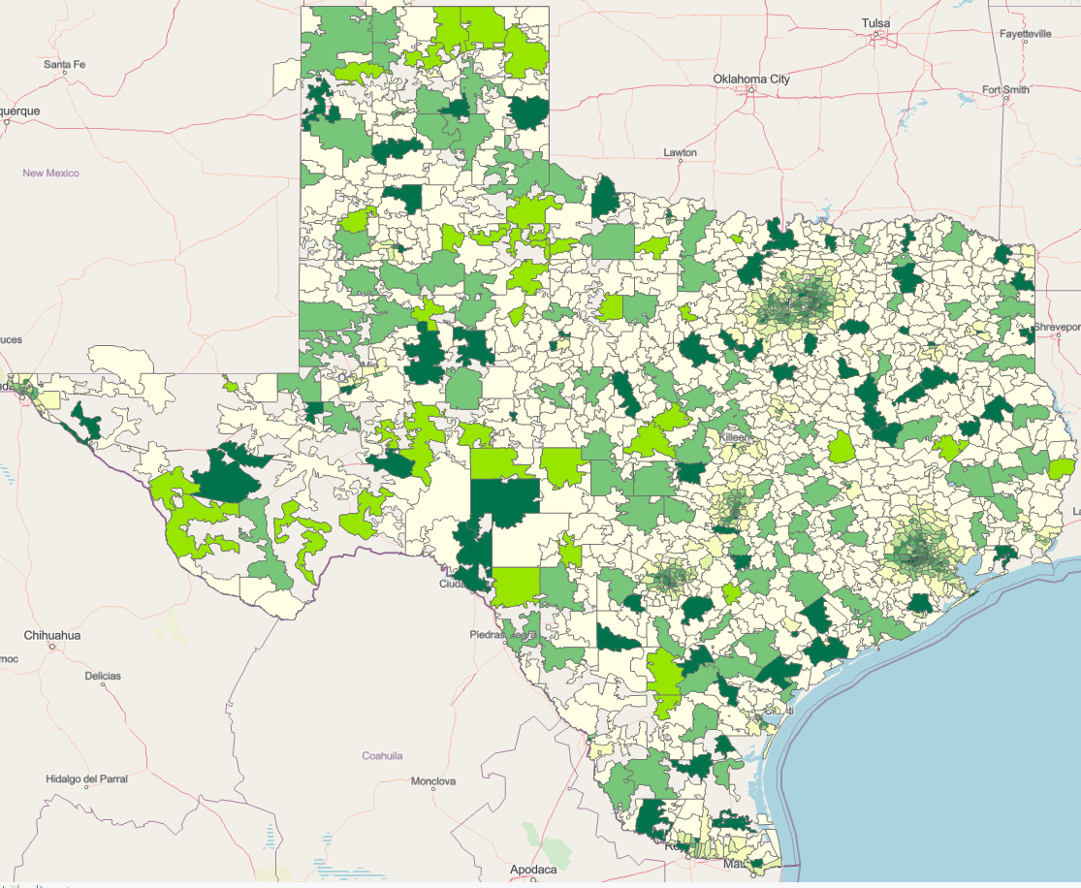
Geospatial Analysis
Optimized locations on Highways which are under 50 miles from another station
Prioritized location categorized in Phases for building a charging station Network

Slide 18
Findings and Recommendations
Our analysis has led us to narrow down our focus to approximately 54 locations for the initial phase of implementation.
In order to determine the optimal number of chargers in each of these areas, we integrated the findings from our geospatial analysis with the outputs of our regression model.
We have included a snippet of Phase 1 locations below,
Zip Code | POP | MED_INC | TOT_EV | Density | CITY_NAME | Phase | Chargers to Install
78572 | 76645 | 22780 | 256 | 0.0005514 | Mission | 1 | 17
75165 | 47183 | 36089 | 194 | 0.0001544 | Waxahachie | 1 | 14
78526 | 58713 | 27496 | 186 | 0.0004783 | Brownsville | 1 | 12
78539 | 36531 | 29580 | 186 | 0.0011524 | Edinburg | 1 | 9
78840 | 46970 | 24070 | 72 | 1.73E-05 | Del Rio | 1 | 7
78611 | 12938 | 32310 | 48 | 1.82E-05 | Burnet | 1 | 7
78114 | 22948 | 34475 | 47 | 2.54E-05 | Floresville | 1 | 7

Slide 19
Findings and Recommendations
Predictions suggest 7-8 350 kW chargers to be installed in suggested areas at an average of $25,000 per charger
Prioritize EV charging infrastructure installation along interstate highways and ZCTAs under Electric Alternative Fuel Corridors
Collaborate with convenience stores, rest areas, and restaurants along highways with enough electricity voltage requirements for EV charging stations
These collaborations present great opportunities for capitalizing from the EV charging station network
Strategically identified charging station locations based on truck traffic, driving, and rest patterns for a competitive edge in the electric truck market.

Slide 20
Data Sources
https://www.mpofcinci.com/blog/whats-the-future-of-electric-vehicles-in-trucking/
https://data.census.gov/
https://data-usdot.opendata.arcgis.com/datasets/alternative-fueling-stations/explore?location=1.082992%2C-64.992833%2C4.30
https://evadoption.com/ev-charging-stations-statistics/charging-stations-by-state/
https://afdc.energy.gov/stations/#/find/nearest?country=US&fuel=ELEC&ev_levels=all
https://namecensus.com/zip-codes/
https://abcnews.go.com/Business/evs-coming-infrastructure-support/story?id=81502192
https://www.visualcapitalist.com/sp/visualizing-americas-electric-vehicle-future/
https://abcnews.go.com/Business/biden-administration-accelerates-plans-national-ev-charging-network/story?id=81719883
https://www.puc.texas.gov/industry/electric/plis/ default.aspx
https://www.puc.texas.gov/industry/electric/directories/rep/alpha_rep.aspx
https://driveelectric.gov/state-plans/
https://theicct.org/publication/update-on-electric-vehicle-costs-in-the-united-states-through-2030/
https://theicct.org/decarbonizing/charging-infrastructure/
https://quickelectricity.com/business-electricity/
https://www.autotrainingcentre.com/blog/infographic-electrifying-future-ev-pickup-trucks/

